Slide 1
Manage and Share Big Data Insights through AWS RedShift, QuickSight, and Lambda
MSBA 6330 Big Data Trends Marketplace
Team 14: Eshan Bhushan, Bradshaw Irish, Likhith Karanuthala,
Ka Lok Carol Ng, and Sheetal Pasam​

Slide 2
Full Video Presentation Hosted on YouTube Here:
https://youtu.be/O6L0bPjqYwA

Slide 3
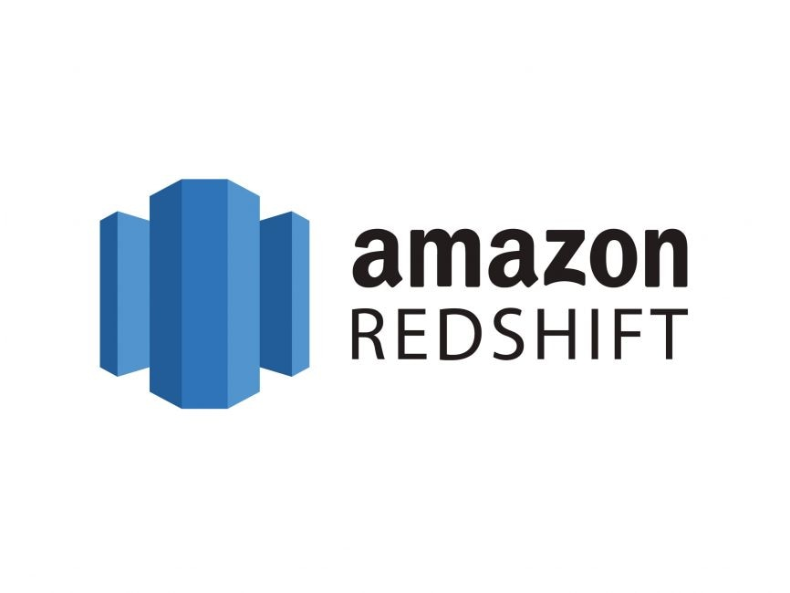





Flexible, Scalable, and On Demand Business Intelligence
RedShift
Handles ultra-high-volume data
Allows fast querying on Big Data
Dependable / scalable / quick access (all benefit of cloud tool)
Multiple security features
QuickSight
Connects to virtually any source
Quick calculations and visualizations for on demand dashboards
Easily shared
Cheap
Lambda
Automated scaling
Modernization of apps
Pay-as-you-go hence cheap
Big Data
Data Warehousing
Visualization
Automated mailing

Slide 4


Who Uses our Data Pipeline?
Data Analysts
Load large data files into Redshift
Perform data wrangling with nearly unlimited concurrent users and no decrease in performance
Use QuickSight for visualizations
Utilize Lambda to setup automated emails
Data Consumers
Company Executives, Marketing and Sales Managers
Receive automated updates on dashboards through emails
Analyze dashboards and extract insights
Drive business decisions

Slide 5

Data Description
Sales Dataset for Iowa state's liquor
Size: ~12.5 Million rows (3.47 GB)
24 features
Data Types
Structured data : Date, Zip Code, Sale Price etc.
Unstructured data : Store address, Item description etc.
Data source: https://www.kaggle.com/datasets/residentmario/iowa-liquor-sales

Slide 6
S3 + RedShift Demo
Demo Hosted on YouTube Here:
https://youtu.be/DXHbHHed9vA

Slide 7
QuickSight Demo
Demo Hosted on YouTube Here:
https://youtu.be/yPrk14ex-ew

Slide 8
Lambda and Simple Email Service (SES) Demo
Demo Hosted on YouTube Here:
https://youtu.be/9kuMvx_Qxd4

Slide 9



Enterprise Data Warehouse Comparison
 | RedShift | Snowflake | SQL Server
Cost Structure | Pay per compute or by bytes scanned | Pay per compute and pay per storage | Pay per license or device
Cloud Based | Yes | Yes | No
Speed | Very Fast | Very Fast+ | Slow
Scaling | Manual | Automatic | None
Flexibility | High | Medium | Low

Slide 10



Enterprise Analytics Dashboard Comparison
 | QuickSight | Tableau Online | Power BI Pro
Monthly Cost | $24 per Author $5 max per Reader | $70 per Author $15 per Reader | $10 per Author or Reader
Cloud Based | Yes | Yes | No
Storage | Adaptive | Fixed | Fixed
Scale to Use | Automatic | Automatic | Manual
Additional Features | High | High | Low

Slide 11


Future Project Extensions through the AWS Stack
Lambda
Run code without having to set up a development space or provision any hardware. Can be used to automate any stage of your pipeline or react to specific events in real time.
SageMaker
Powerful Machine Learning framework can connect to S3 or RedShift to produce models for demand prediction, inventory optimization, sentiment analysis, etc.
Kinesis
Ingest data in real time from a variety of sources or formats. Connect data pipeline to another service, process through Lambda, or store in S3 or RedShift directly.

